Slide 1
Notes:
1

Slide 2
Master thesis: Routing Algorithms for Programmable Photonics circuits
Research Group Hardware and Embedded Systems(HES),
Photonics Research Group(PRG), IDLab
Xiaoke Wang Promoter: Prof. dr. ir. Dirk Stroobandt, Prof. dr. ir. Wim Bogaerts
Counselors: Ferre Vanden Kerchove, Raveena Ramanand Raikar

Slide 3
Overview
Background and four routing problems
Routing algorithms(solvers) aims to the problems
Conclusion

Slide 4
1. Routing problems
4
Notes:
4

Slide 5
Hexagonal mesh
Hexagonal mesh
Three sates of the
2x2 tunable coupler

Slide 6
Routing model
Radius
1
Virtual coupler
Real coupler
Hexagonal mesh size (radius = 1)
Notes:
and so on
6

Slide 7
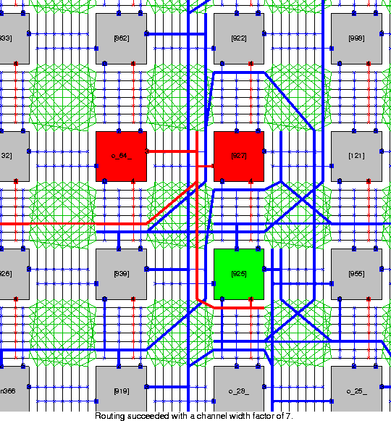
Motivation
Routing model’s relationship between electronics router and programmable photonics router
FPGA architecture *
Programmable photonic circuits hexagonal architecture

Slide 8
Routing Problems
Single source single sink (connection)
Certain pathlength problem
Shortest pathlength problem (Aurora)√
Single source multiple sinks problem (net)
Certain pathlength
Shortest pathlength

Slide 9
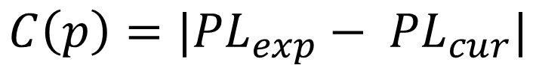
1. Certain pathlength (connection)
$$C\left(p\right)=|{PL}_{exp}− {PL}_{cur}|$$
Connection routing problem (single source single sink problem)
L
Optical ring resonator schematic
Mach-Zehnder Interferometer schematic

Slide 10
3. Certain pathlength (net)
Net routing problem (single source multi-sinks problem)
1x4 Optical true time delay (OTTD) lines network for microwave linear antenna array beamforming
10

Slide 11
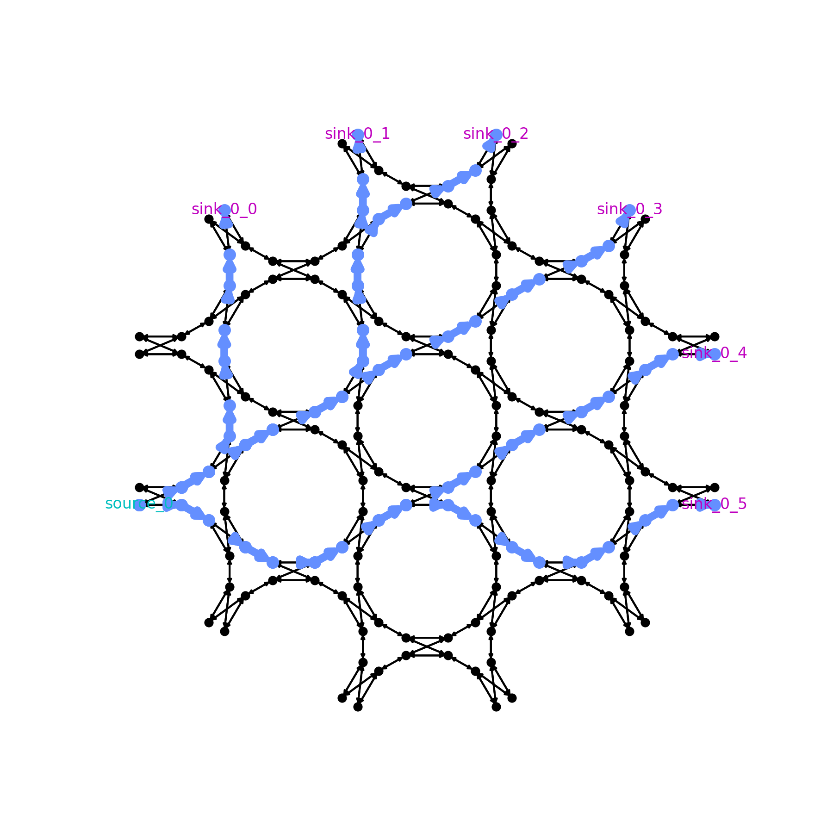
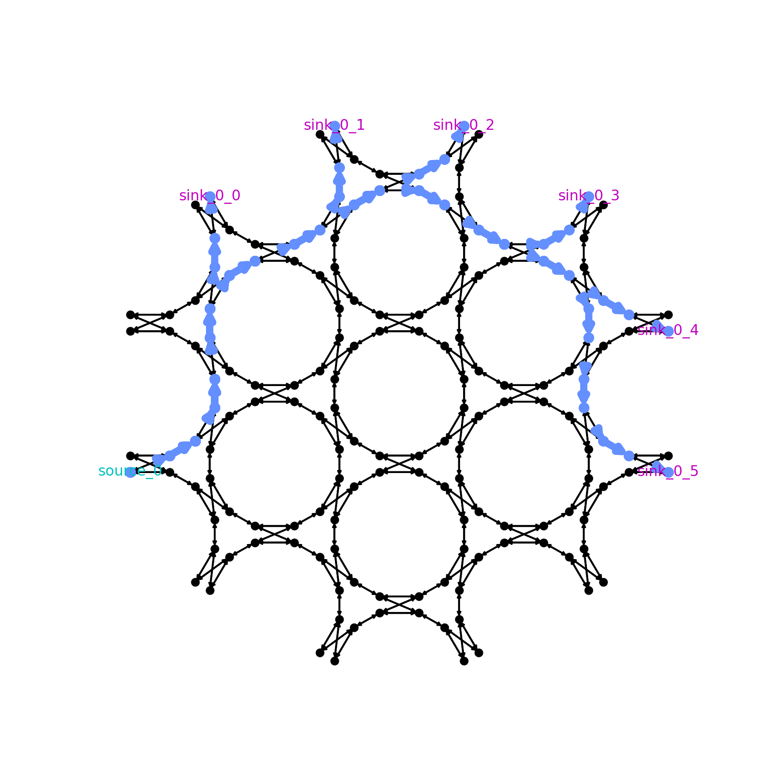
4. Shortest pathlength (net)
Different solutions with different total pathlength (routing resources usage)
Routing resources optimization
Total net length = 27
Total net length = 17

Slide 12
2. Solvers (algorithms)
12
Notes:
12

Slide 13
Solvers
Single source single sink (connection)
Certain pathlength problem (CPL)
Constrained-DFS
Constrained-Dijkstra/ A* / K-shortest
Shortest pathlength problem √
Single source multiple sinks problem (net)
Certain pathlength
Shortest pathlength

Slide 14
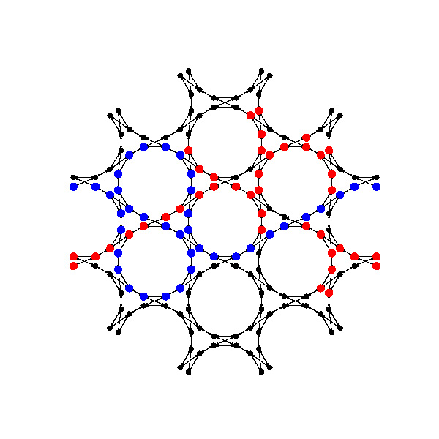
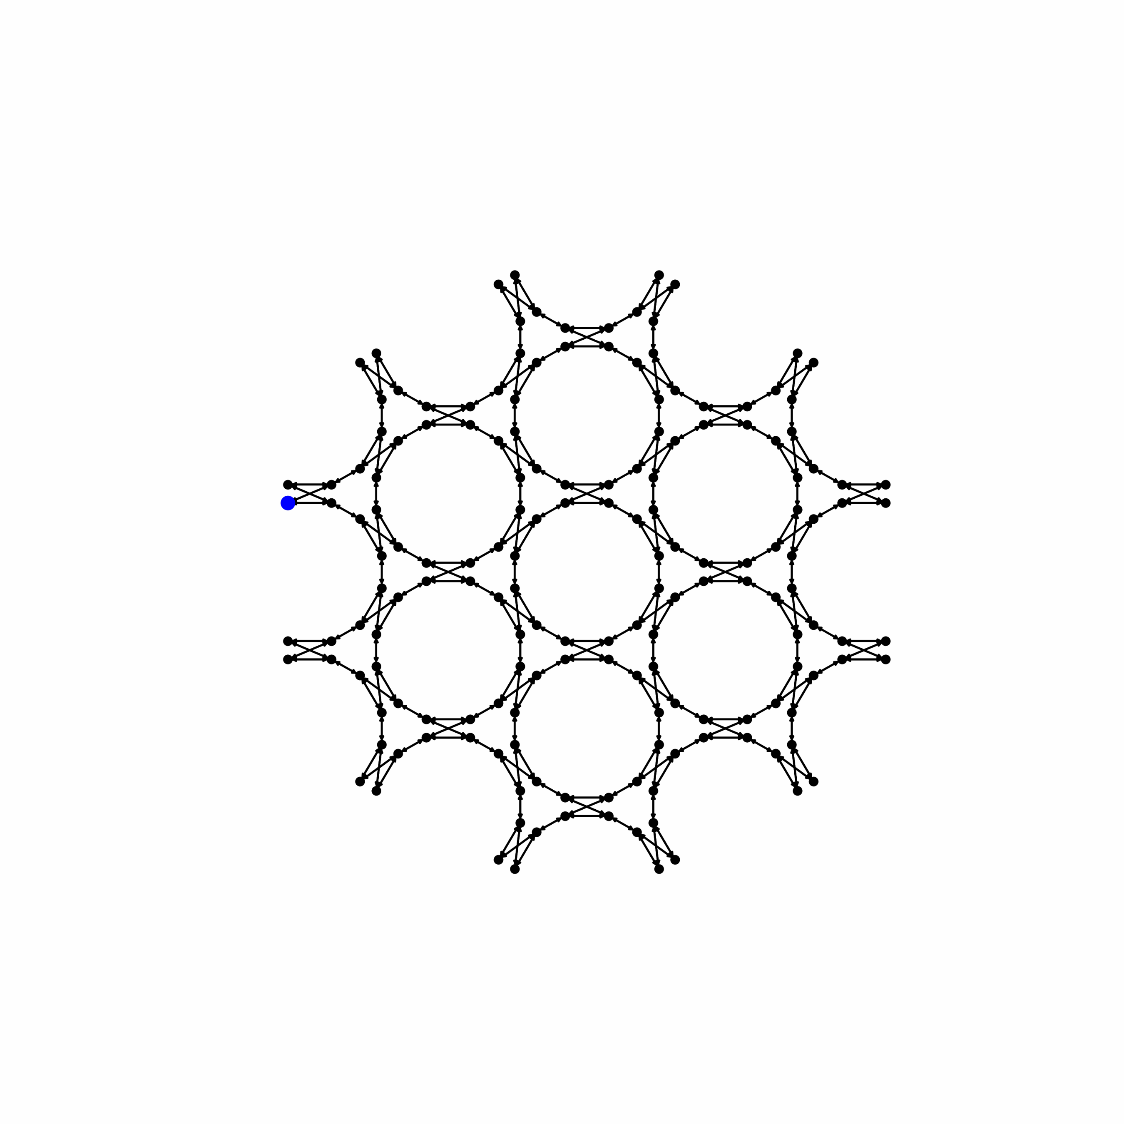
1. solvers: cpl connection routing
1.1 Constrained Depth-first search algorithm
A greedy algorithm
The router will start backtracking:
the current path breaks the physicality restriction
reach the expect pathlength (EP) but not the sink
Source
Sink
Source
Sink
Final used nodes
Unused nodes
Without pruning
Expect pathlength: 18
With pruning
Expect pathlength: 18

Slide 15
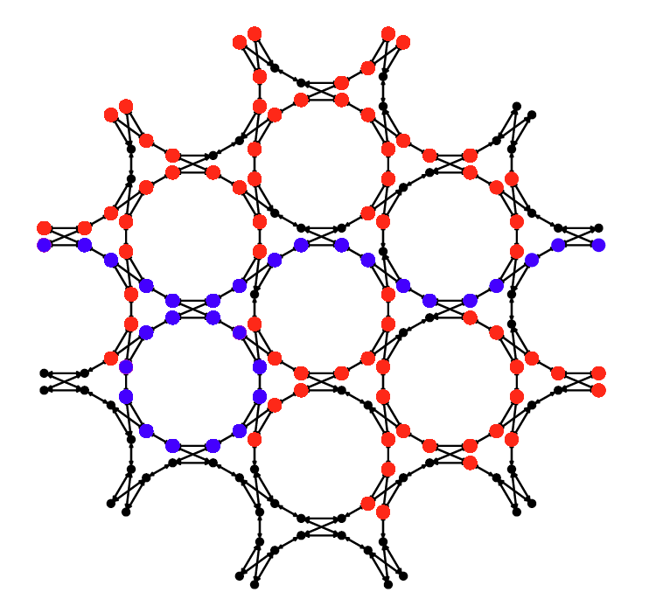
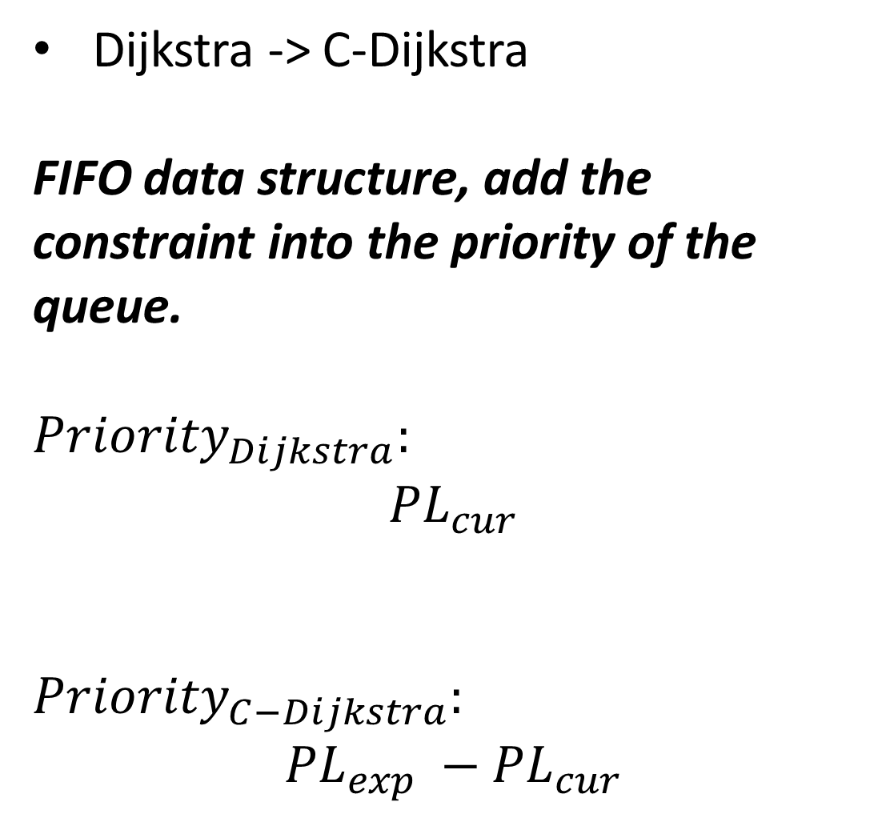
1. solvers: cpl connection routing
1.2. Constrained Dijkstra
Final used nodes
Unused nodes
Dijkstra -> C-Dijkstra
FIFO data structure, add the constraint into the priority of the queue.
$${Priority}_{Dijkstra}:$$
$${PL}_{cur}$$
$${Priority}_{C−Dijkstra}:$$
$${PL}_{exp} −{PL}_{cur}$$
Source
Sink
Expect pathlength: 14

Slide 16
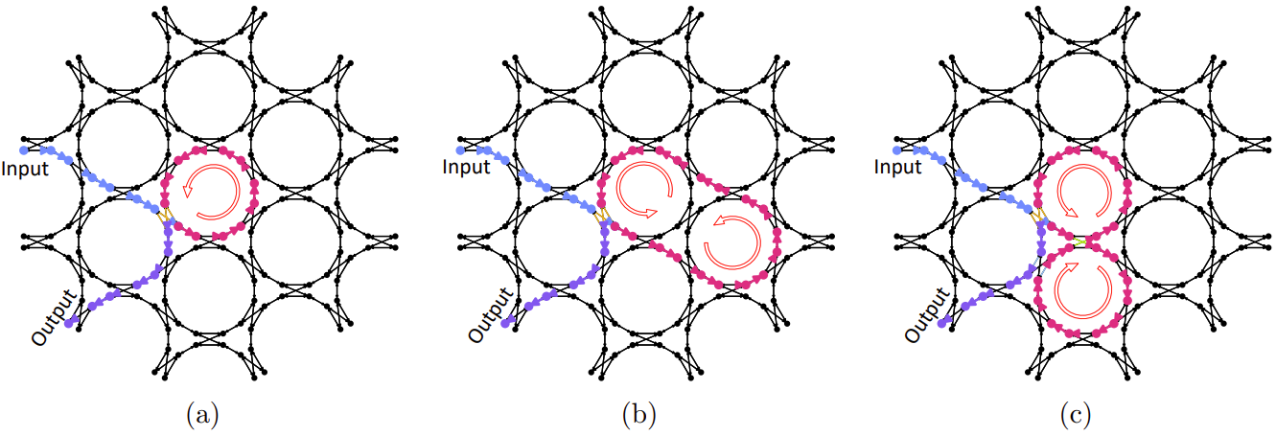
1. Applications: ORRs
Schematic (top)
Routing solution on hexagonal mesh (bottom)
BUL: basic unit length

Slide 17
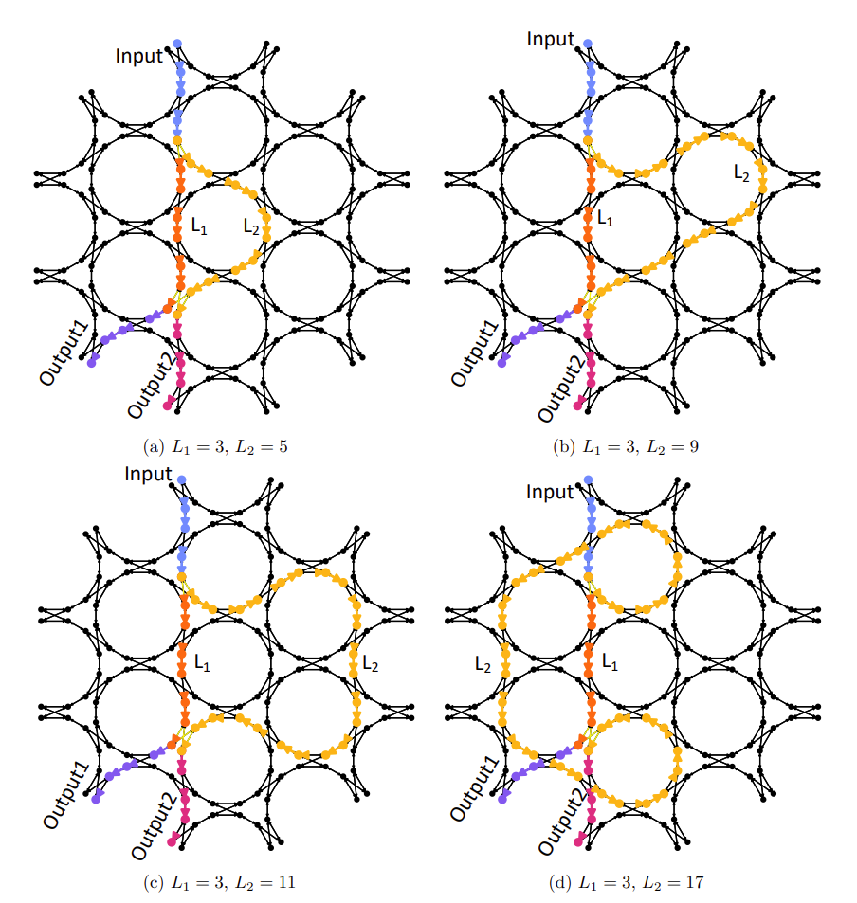
1. Applications: MZIs
Schematic (left)
Routing solution on hexagonal mesh (right)

Slide 18
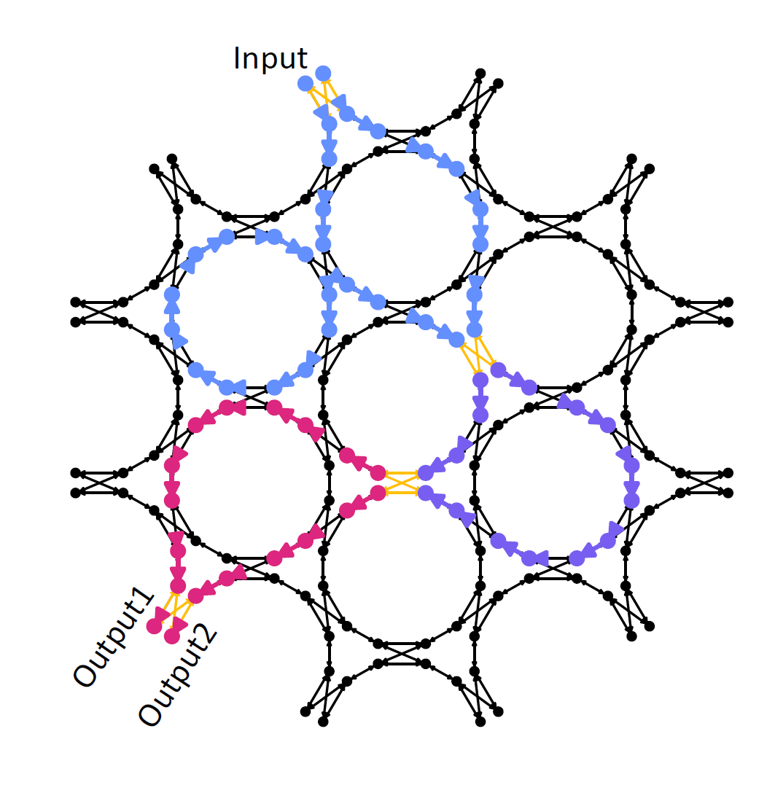
1. Applications: 3-stage-MZI
Schematic (left)
Routing solution on hexagonal mesh (right)

Slide 19
Solvers
Single source single sink (connection) √
Certain pathlength (CPL) √
Shortest pathlength √
Single source multiple sinks problem (net)
Certain pathlength
Constrain-DFS
Congestion negotiation (CN) based
Shortest pathlength

Slide 20
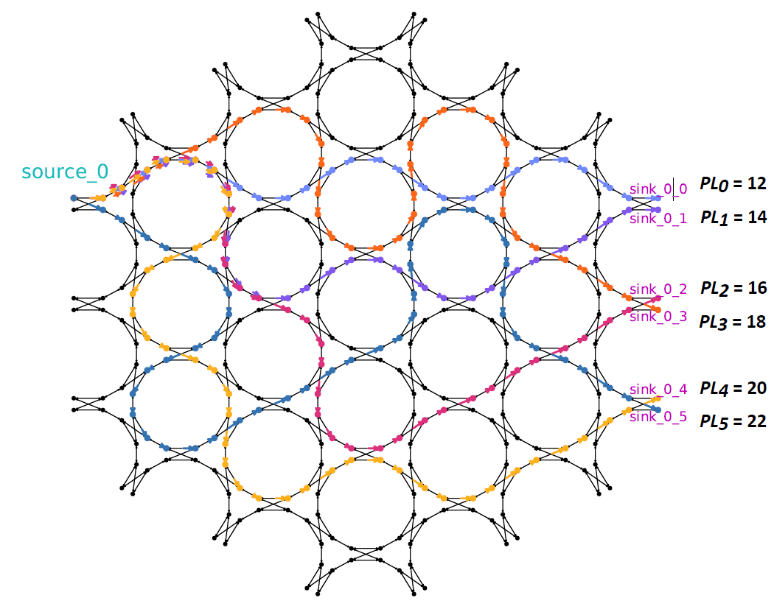
3. Applications: OTTD 1x6 network
3.1. Achieved by Constrained-DFS
Pathlength
Schematic
Solution
Notes:
arithmetic progression

Slide 21
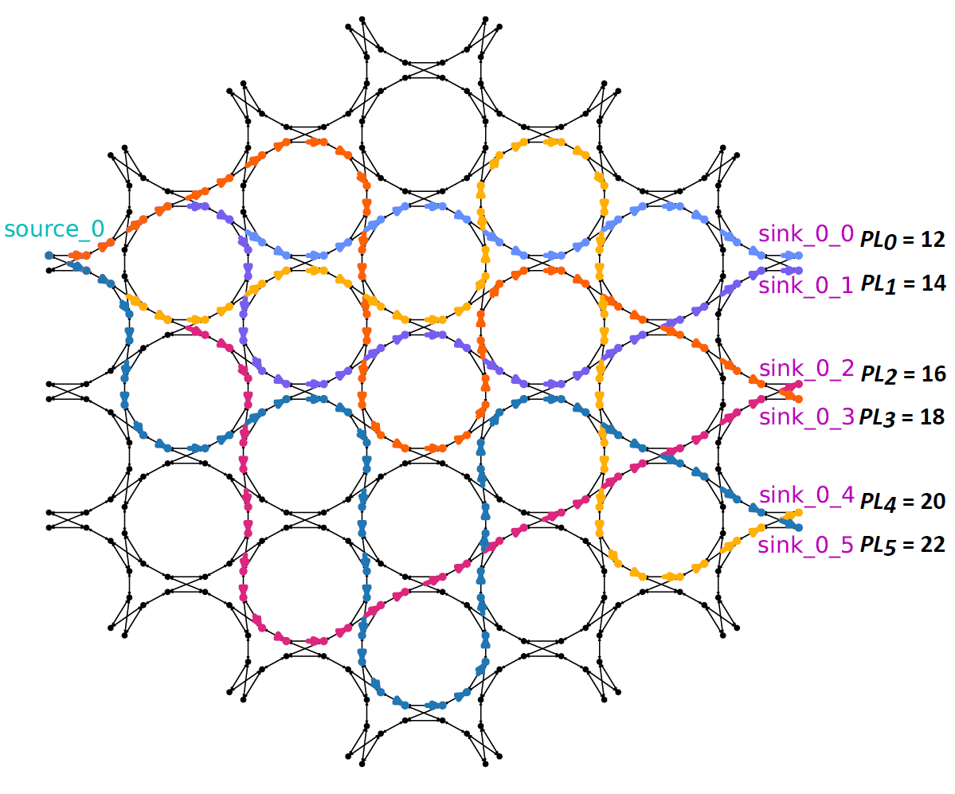
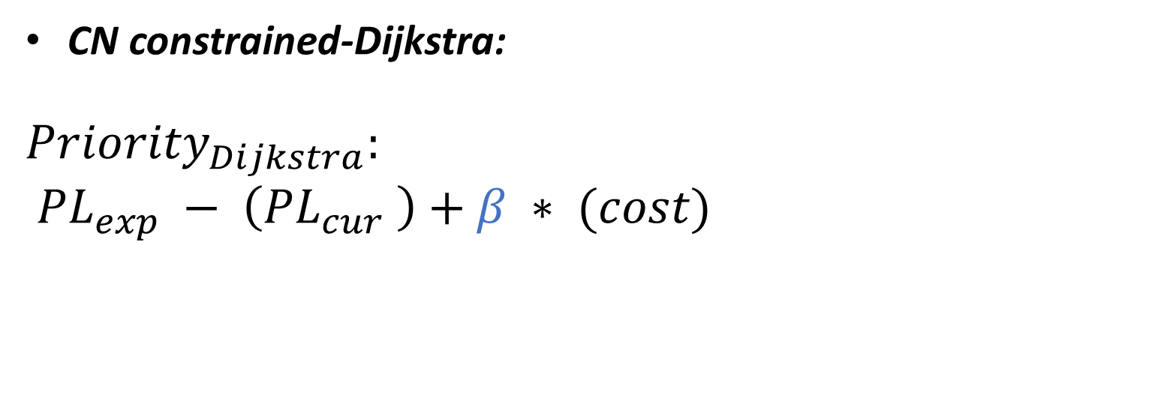
3. Applications: OTTD 1x6 network
3.2. Congestion Negotiation:
Combined with Constrained-Dijkstra and Constrained-A*
Pathlength
CN constrained-Dijkstra:
$${Priority}_{Dijkstra}:$$
$${PL}_{exp} − \left({PL}_{cur} \right)+β ∗ (cost)$$
Fixed length
Dynamic cost (CN)
Empirically balance factor β for taking 0.4 and 0.5

Slide 22
Solvers
Single source single sink (connection) √
Certain pathlength (CPL) √
Shortest pathlength √
Single source multiple sinks problem (net)
Certain pathlength √
Shortest pathlength (resources optimization)
CRoute
Comparison (Scaling and Performance)

Slide 23
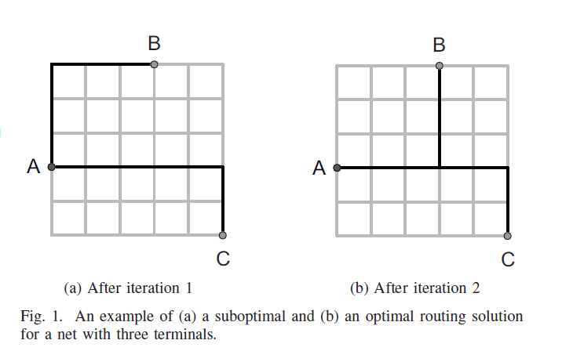
4.Connection-based-router (CROute)
Connection-based-router (Congestion Negotiation Mechanism):
share(n) as denominator of the cost function, encourage legal common usage in a net
rip-up by connection, speed up routing
An example of a sub-optimal (left) and an optimal (right) routing solution for a net with three terminals

Slide 24
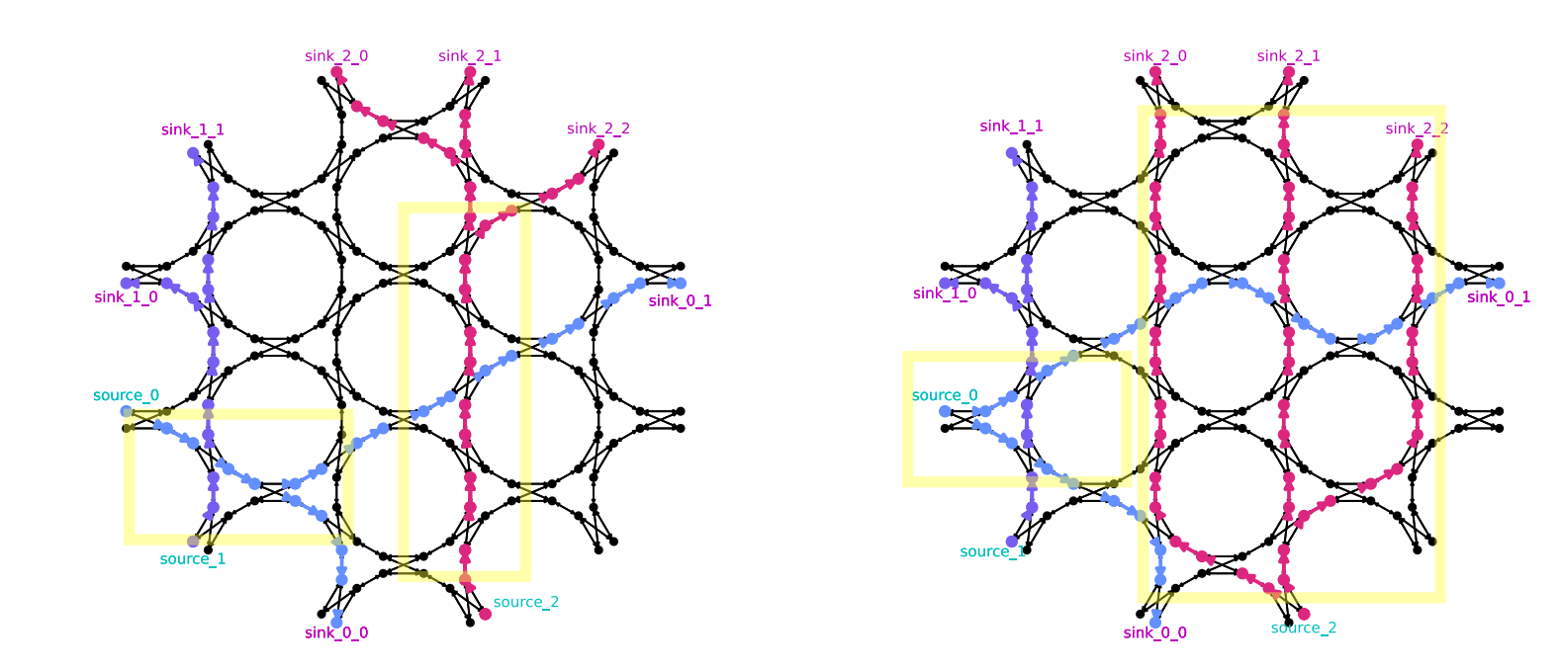
4. Shortest Net routing
Comparison between CRoute and Pathfinder
Solution by CRoute
Solution by Pathfinder
CRoute with a denominator in cost function
Notes:
11
8+7+6

Slide 25
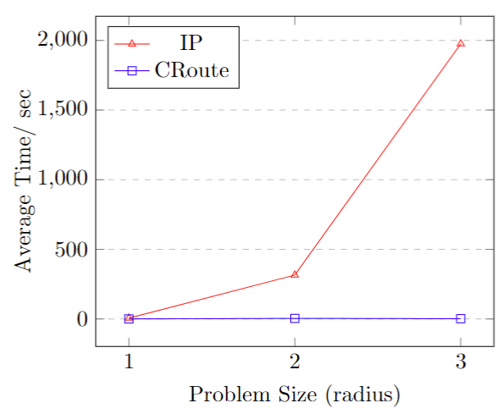
4. Scaling comparison
Comparison between CRoute and integer programming (IP)

Slide 26
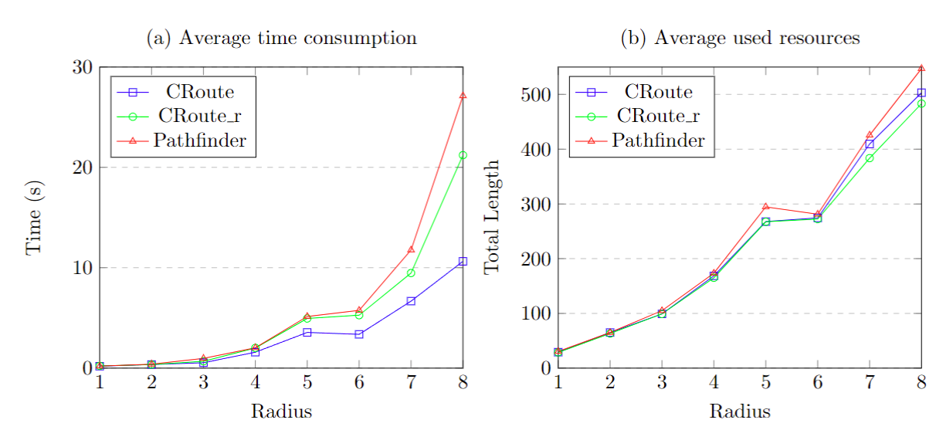
4. Performance comparison
Comparison between CRoute and Pathfinder
CRoute_r refers to the CRoute algorithm but ripping up based on the net rather than connection.
The resources used even less, and time consumption in between.
26
Notes:
26

Slide 27
3. conclusion

Slide 28
Conclusion and prospect
Single source single sink (connection) √
Certain pathlength (CPL) √
Shortest pathlength √
Single source multiple sinks problem (net)
Certain pathlength √
Shortest pathlength (resources optimization) √
Certain pathlength routing (connection, net)
C-A*, C-Dijkstra, C-DFS, K-shortest for connection
C-DFS and CN based for net
High performance net routing (CRoute)
Applications on MZIs, ORRs, cascade MZIs, OTTDs

Slide 29
Future work
Estimation in hexagonal mesh for pruning and A* in CPL routing algorithms
Other optical effects (thermal, split and recombine)
Beamforming, fan in interconnects

Slide 30
question

Slide 31
bibliography
[1] Bogaerts, Wim, et al. "Programmable photonic circuits." Nature 586.7828 (2020): 207-216.
[2] Zhuang, Leimeng, et al. "Programmable photonic signal processor chip for radiofrequency applications." Optica 2.10 (2015): 854-859.
[3] Pérez, Daniel, et al. "Multipurpose silicon photonics signal processor core." Nature communications 8.1 (2017): 636.
[4] Chen, Xiangfeng, et al. "Graph representations for programmable photonic circuits." Journal of Lightwave Technology 38.15 (2020): 4009-4018.
[5] López, Aitor, et al. "Auto-routing algorithm for field-programmable photonic gate arrays." Optics Express 28.1 (2020): 737-752.
[6] Kerchove, Ferre Vanden, et al. "Adapting Routing Algorithms to Programmable Photonic Circuits." 2022 European Conference on Optical Communication (ECOC). IEEE, 2022.
[7] Vansteenkiste, Elias, Karel Bruneel, and Dirk Stroobandt. "A connection-based router for FPGAs." 2013 International Conference on Field-Programmable Technology (FPT). IEEE, 2013.
[8] Vercruyce, Dries, Elias Vansteenkiste, and Dirk Stroobandt. "CRoute: a fast high-quality timing-driven connection- based FPGA router." 2019 IEEE 27th Annual International Symposium on Field-Programmable Custom Computing Machines (FCCM). IEEE, 2019.
[9] McMurchie, Larry, and Carl Ebeling. "Pathfinder: A negotiation-based performance-driven router for FPGAs." Proceedings of the 1995 ACM third international symposium on Field-programmable gate arrays. 1995.

Slide 32
Appendix

Slide 33
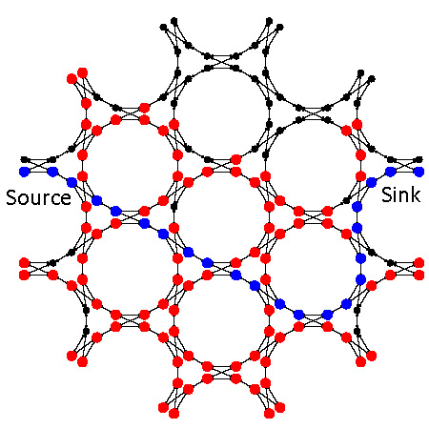
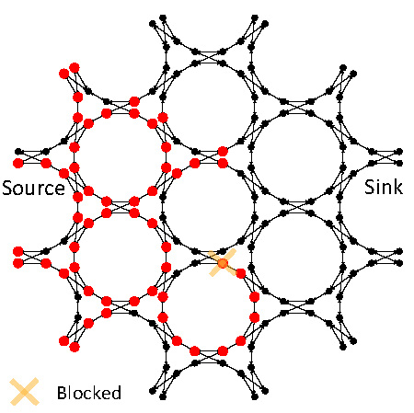
Constrained-Dijkstra
1.2. Constrained Dijkstra
With the visited restriction (left) and without the visited restriction (right)

Slide 34
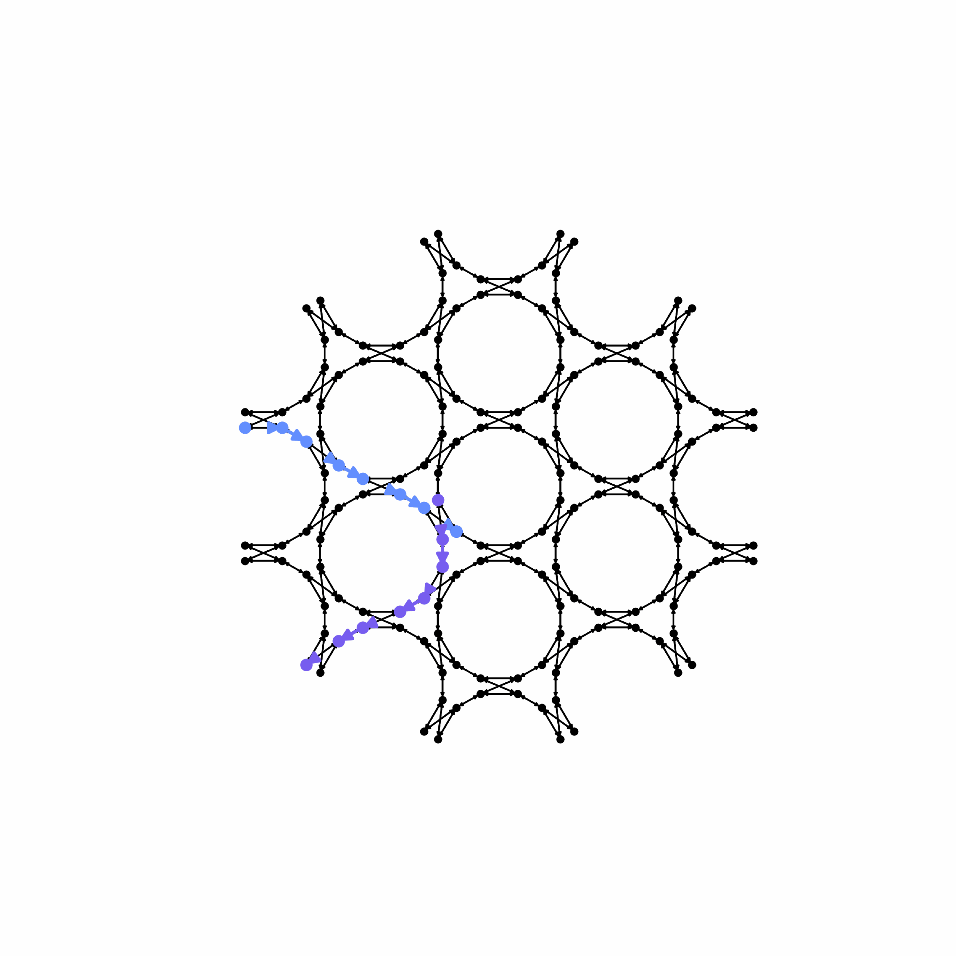
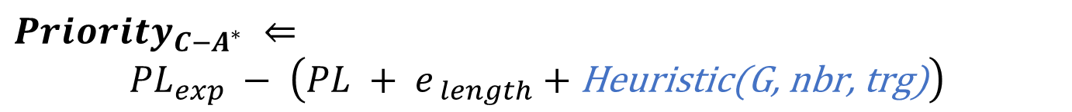
Applications: ORRs
By Constrained-A*:
$${Priority}_{C−A^{∗}} ⇐$$
$${PL}_{exp} − \left(PL + e_{ length}+\text{Heuristic}\text{(}\text{G}\text{, }\text{nbr}\text{, }\text{trg}\text{)}\right)$$
Ring resonator application routing process (animation)
expect
current length
estimation
EP = 6
EP = 10
EP = 12
Expect Pathlength corresponding to 6 (left), 10 (mid), 12 (right)

Slide 35
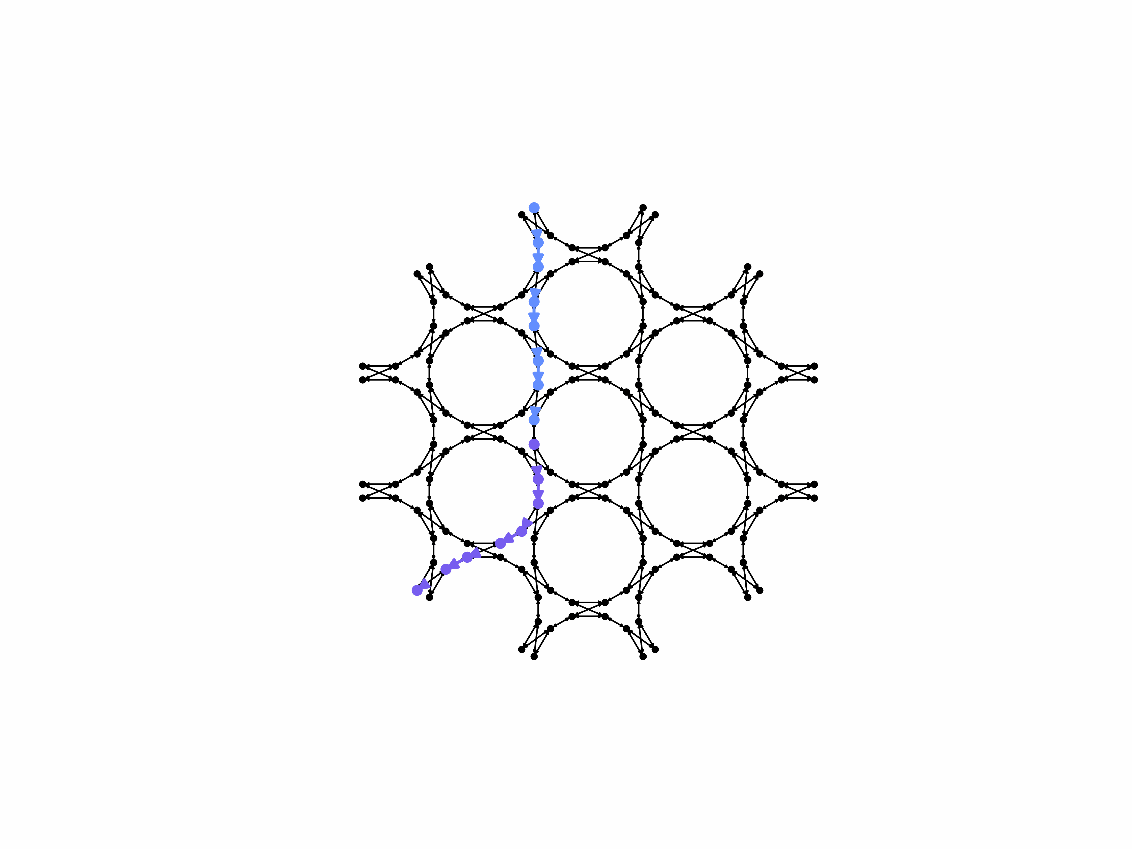
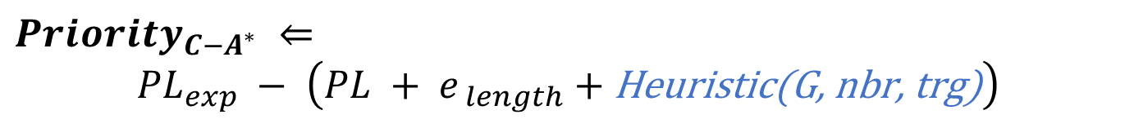
By Constrained-A*:
Applications: ORRs
$${Priority}_{C−A^{∗}} ⇐$$
$${PL}_{exp} − \left(PL + e_{ length}+\text{Heuristic}\text{(}\text{G}\text{, }\text{nbr}\text{, }\text{trg}\text{)}\right)$$
Ring resonator application routing process (animation)
(EP = 15)
(EP = 11)

Slide 36
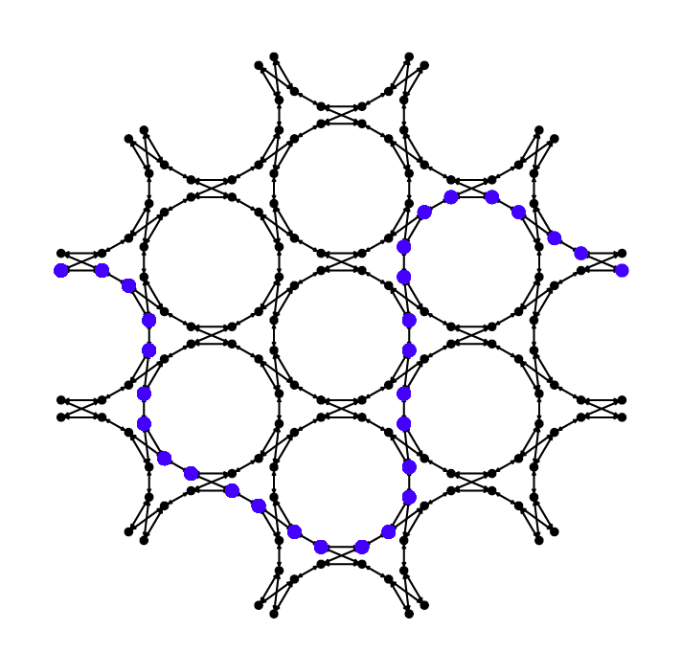

Constrained-A*
Priority with a distance estimation
$${Priority}_{C−A^{∗}}:$$
$${PL}_{exp} − \left(PL + e_{ length}+\text{Heuristic}\text{(}\text{G}\text{, }\text{nbr}\text{, }\text{trg}\text{)}\right)$$
Final used nodes
Unused nodes
Obtained by Dijkstra
Obtained by Constrained A*
EP = 14
Notes:
Mathmatical estimation based on the topology, the router will speed up

Slide 37
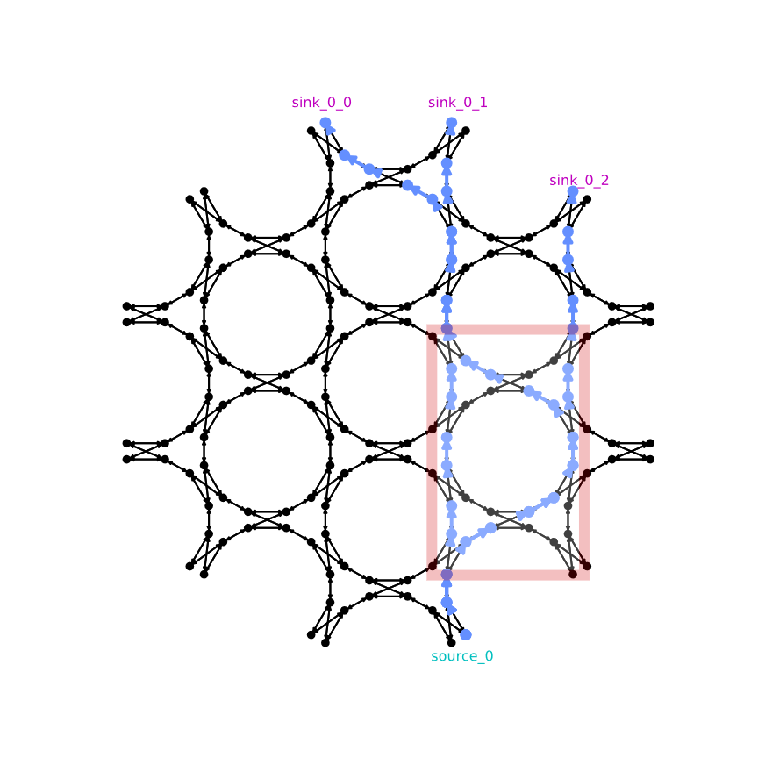
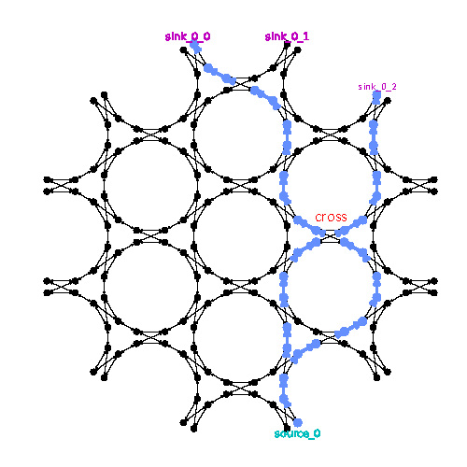
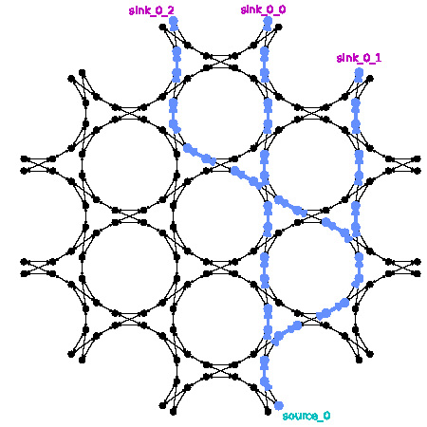
2. Solvers: CPL net routing
1. Achieved by Constrained-DFS
Issue 1: parasitic interferometer
Issue 2: block 2nd sink
Final CPL net solution

Slide 38
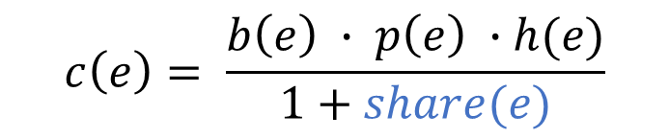
Croute vs pathfinder
Croute Pathfinder
Cost function:
$$c\left(e\right)= \frac{b\left(e\right) ∙ p\left(e\right) ∙h(e)}{1+share(e)}$$
$$c(e)= (b\left(e\right)+h(e)) ∗p(e)$$
Routing schedule:
Rip up by connection
Rip up by Net
Result (demo):
Solution by CRoute
Solution by Pathfinder

Slide 39
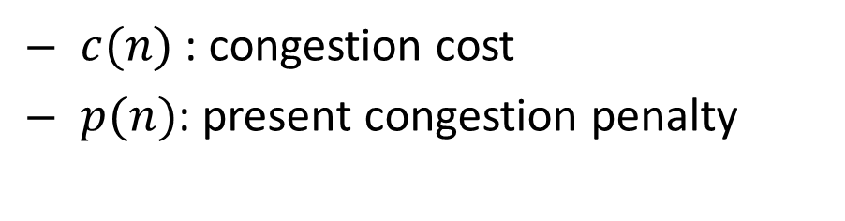
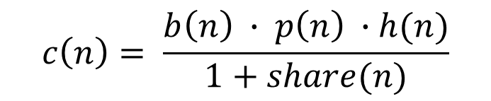
Connection-based-router
Congestion Negotiation Mechanism:
1. share(n) as denominator, encourage common usage in a net
$$f(n) = c_{prev} (n) + c(n) + α · c_{exp} (n)$$
$$c\left(n\right)= \frac{b\left(n\right) ∙ p\left(n\right) ∙h(n)}{1+share(n)}$$
$c(n)$: congestion cost
$p(n)$: present congestion penalty
An example of a sub-optimal (a) and an optimal (b) routing solution for a net with three terminals
2. rip-up connection, speed up routing

Slide 40
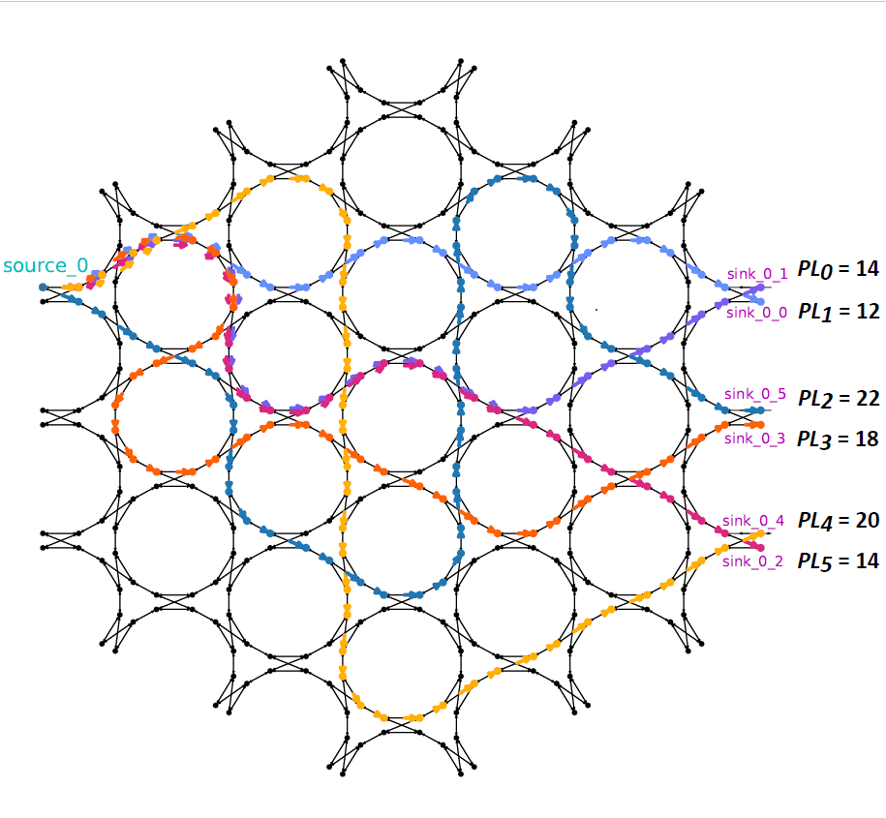
OTTD 1x6 network
1. Achieved by Constrained-DFS
For irregular expect
pathlength (EP)
With rescheduling
shortest first
Sharing restriction
Allow sharing only when same length from source

Slide 41
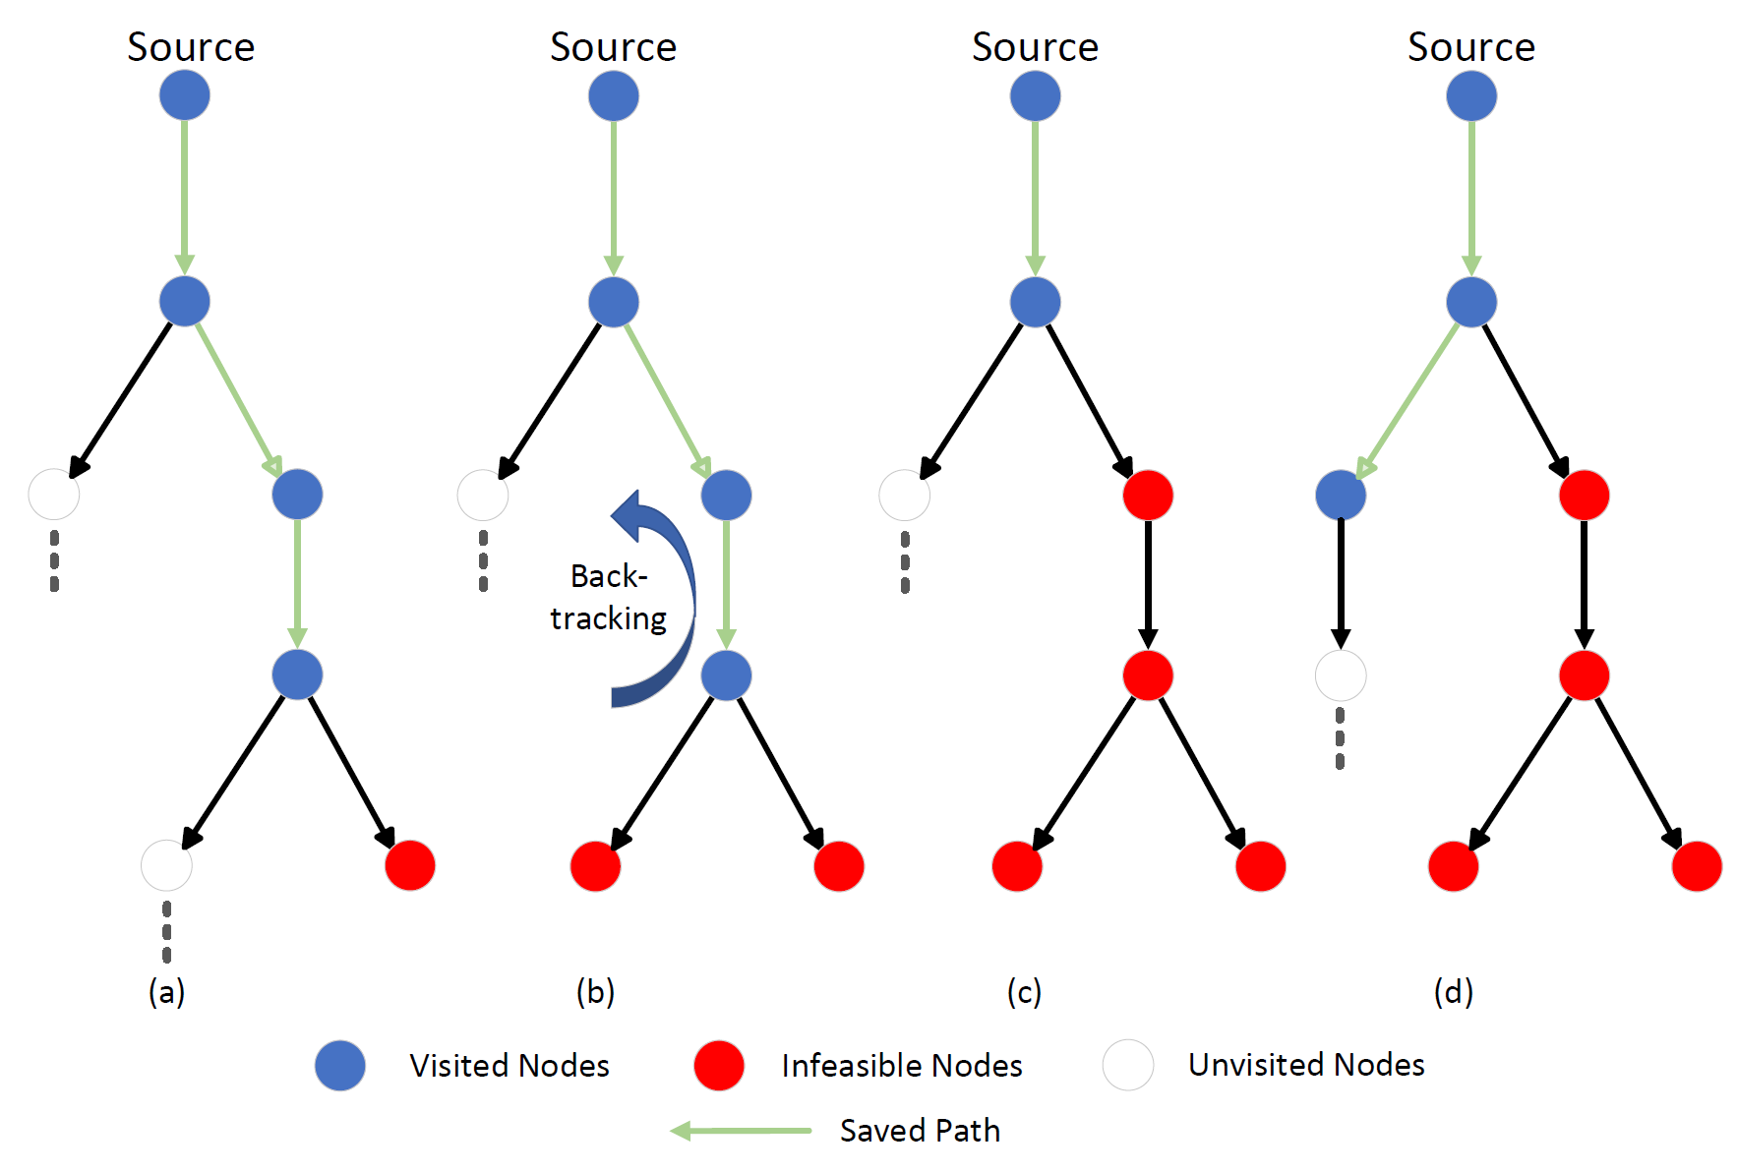
Depth-first

Slide 42



Xiaoke Wang Master student DEPARTMENT OF ELECTRONICS AND INFORMATION SYSTEMS DEPARTMENT OF INFORMATION TECHNOLOGY E Xiaoke.Wang@ugent.be www.ugent.be
Universiteit Gent @ugent
@ugent Ghent University

